Slide 1
AI-Driven Sustainable Energy Management: Forecasting, Optimization, and Commercial Viability of Solar Energy Systems
Team Members
J.Abinesh 952521104001 - IV CSE
T.Selvin 952521104046 - IV CSE
S.Siva 952521104047 - IV CSE
P.Srinidas 952521104050 - IV CSE
GUIDED BY

Slide 2
Abstract
AI-Driven Sustainable Energy Management
The increasing dependence on solar energy requires intelligent management to handle its variability and enhance efficiency.
This project leverages supervised learning algorithms to:
Analyze solar power production
Optimize energy storage
Predict inverter failures to minimize downtime and costs
AI-driven forecasting enhances electricity production predictions, improving grid integration and commercial viability.
By applying machine learning, the system ensures:
Stable power distribution
Improved efficiency
Economic viability of renewable energy

Slide 3
Domain
Domain: Artificial Intelligence & Machine Learning in Renewable Energy
This project falls under the domain of Artificial Intelligence (AI) and Machine Learning (ML) with applications in Renewable Energy Management.
AI and ML are used to:
Analyze solar power production patterns.
Optimize energy storage and distribution.
Predict inverter failures, reducing downtime and maintenance costs.
Enhance electricity production forecasting for better grid integration.
By applying AI-driven solutions, the project ensures a more efficient, reliable, and economically viable solar energy system.
🔹 Technologies Used: Machine Learning, Supervised Learning Algorithms, AI-Based Forecasting

Slide 4
Approach to Solving the Problem
AI-Driven Approach for Solar Energy Management
Data Collection & Preprocessing
Gather solar power production & inverter performance data.
Clean & normalize data for ML model training.
Machine Learning Models for Prediction
LSTM Model → Forecasts future solar power generation.
Random Forest Classifier → Predicts inverter failures.
Optimization & AI-Based Decision Making
AI optimizes energy storage & power distribution.
Reduces downtime & improves grid integration.
Real-Time Deployment & Continuous Learning
Live monitoring with feedback loops for continuous improvement.

Slide 5
Methodology

Slide 6
LSTM Model for solar power prediction. Random Forest Classifier for inverter failure detection.
Gather solar power production and inverter performance data.
Implement real-time AI predictions to optimize energy management.
Data Collection
Data Preprocessing
Model Selection & Training
Model Evaluation
Deployment
Clean and transform data for machine learning models.
Assess accuracy and fine-tune hyperparameters.

Slide 7
Workflow Diagram
Data Collection
Gather solar power, inverter performance, and weather data.
Machine Learning Model Execution
Use LSTM for power forecasting and Random Forest for inverter failure detection.
Data Preprocessing & Feature Engineering
Clean, normalize, and extract relevant features.
AI-Based Optimization & Decision Making
Optimize energy distribution, reduce downtime, and improve grid integration.

Slide 8
Implementation
Technologies & Tools Used
Python – Core programming language
TensorFlow & PyTorch – Deep learning model training
Scikit-Learn – ML model implementation & evaluation
Pandas & NumPy – Data preprocessing & analysis
Streamlit – Web-based visualization & real-time monitoring
Models Implemented
LSTM/GRU – Solar power forecasting (time-series prediction)
XGBoost/Random Forest – Inverter failure detection (classification)
CNN/LSTM Hybrid – Feature extraction & advanced time-series modeling

Slide 9
Results & Analysis
Model Performance & Accuracy
LSTM/GRU: Achieved high accuracy in solar power forecasting with minimal error.
XGBoost/Random Forest: Effectively detected inverter failures with high precision & recall.
CNN/LSTM Hybrid: Improved feature extraction for time-series modeling.
Key Findings AI-based forecasting reduced energy wastage by optimizing power distribution. Inverter failure prediction helped minimize downtime & maintenance costs. Improved grid integration by enhancing prediction accuracy.

Slide 10
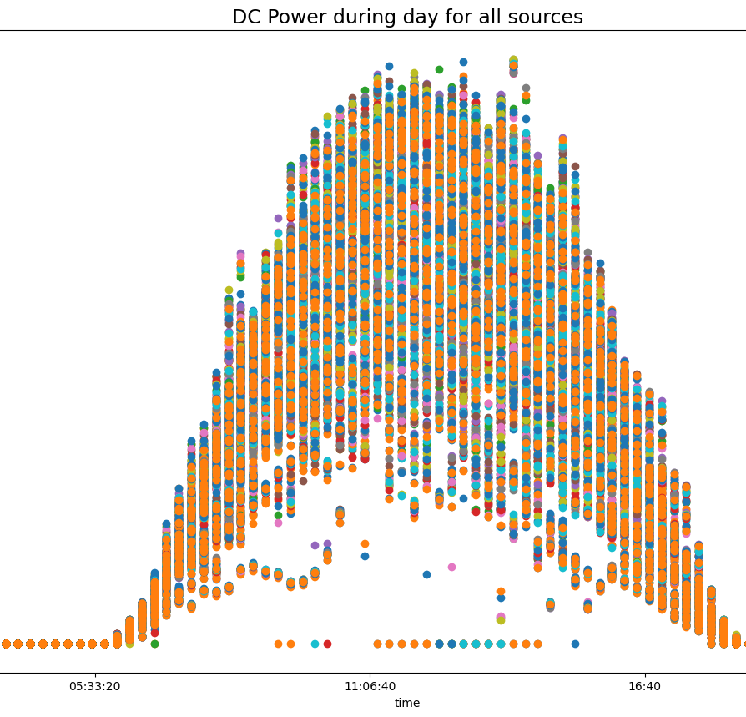
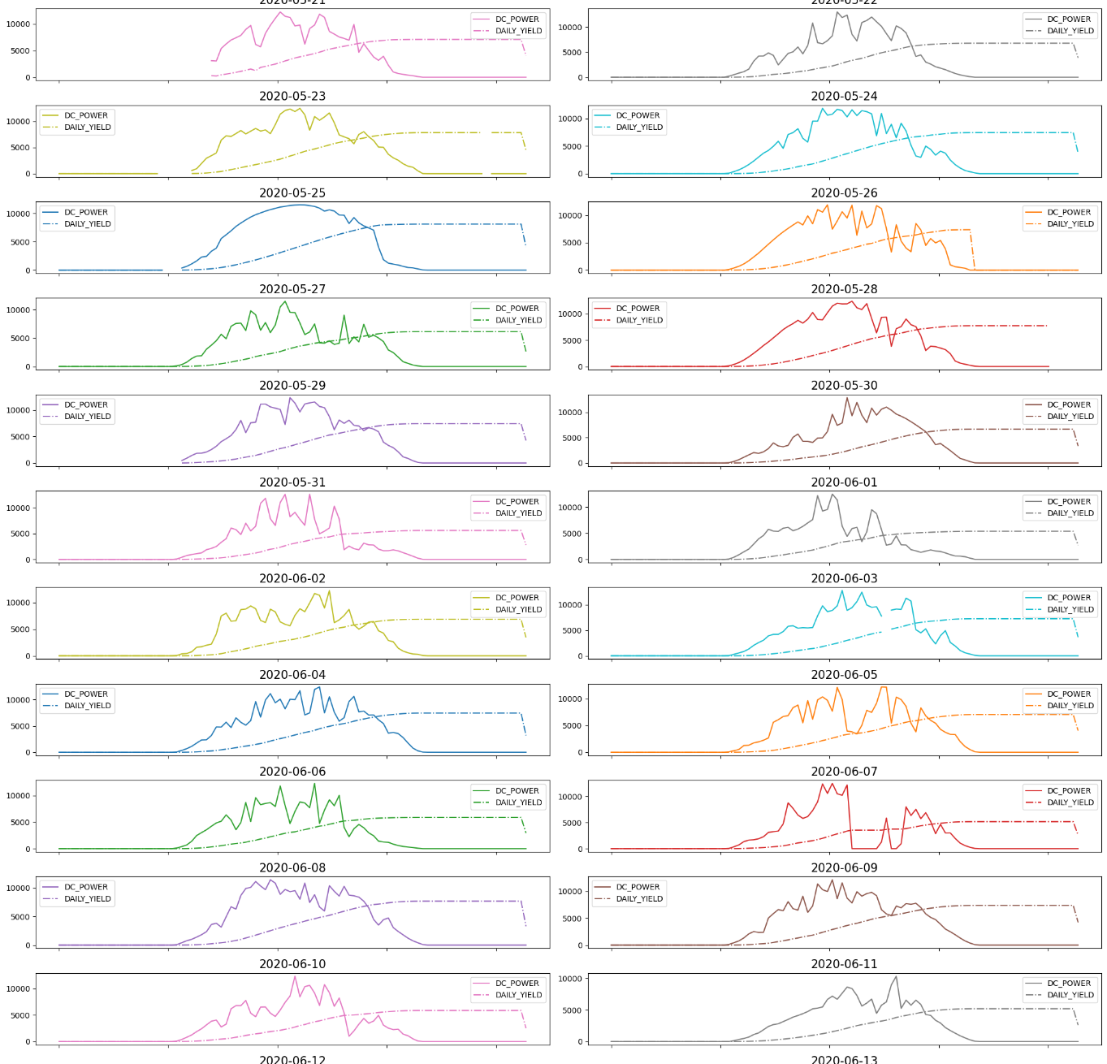
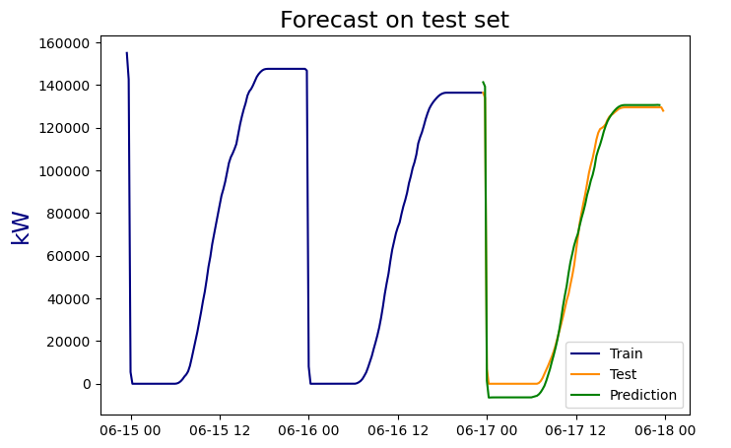
Graphs & Charts:
Line plot of actual vs. predicted solar power output.
Confusion matrix & accuracy scores for inverter failure detection.
Feature importance analysis for Random Forest/XGBoost.

Slide 11
Challenges Faced & Solutions
1️⃣ System Freezing & Performance Issues Challenge: Running multiple applications caused system lag due to an Intel Core i3-9100F with 8GB RAM. Solution: Optimized memory usage, limited parallel processing, and used batch processing for ML tasks.
2️⃣ Real-Time Deployment of AI Models Challenge: Ensuring smooth real-time AI inference with Streamlit and ML models. Solution: Used optimized model serialization (joblib/Pickle) and reduced latency by implementing asynchronous data processing.
3️⃣ Accuracy & Model Optimization Challenge: Initial LSTM & Random Forest models had lower-than-expected accuracy. Solution: Tuned hyperparameters, increased dataset quality, and used CNN/LSTM Hybrid for better feature extraction.
4️⃣ Energy Forecasting & Grid Integration Challenge: Fluctuations in solar power predictions affected optimization. Solution: Implemented rolling window predictions and adaptive learning to adjust forecasts based on new data.
5️⃣ Visualization & User Interaction Issues Challenge: Streamlit dashboard was slow & unresponsive with large datasets. Solution: Used caching techniques (st.cache) and optimized DataFrame operations for better performance.

Slide 12
Conclusion
🔹AI-driven solar energy management enhances efficiency, reduces costs, and optimizes power distribution.
🔹LSTM & GRU models accurately forecast solar power generation, improving grid integration.
🔹Random Forest/XGBoost effectively detects inverter failures, reducing downtime.
🔹Streamlit-based dashboard provides real-time monitoring for better decision-making.

Slide 13
Future Scope
🔹 Integration with IoT Sensors – Real-time data collection from solar panels for enhanced AI predictions. 🔹 Hybrid AI Models – Combining Reinforcement Learning & Deep Learning for better energy optimization. 🔹 Scalability & Cloud Deployment – Deploying on AWS/GCP for large-scale implementation. 🔹 Smart Grid Integration – AI-driven adaptive energy distribution for efficient power management. 🔹 Predictive Maintenance – Advanced AI models for proactive fault detection & self-healing energy

Slide 14

Thank You.

